Slide 1
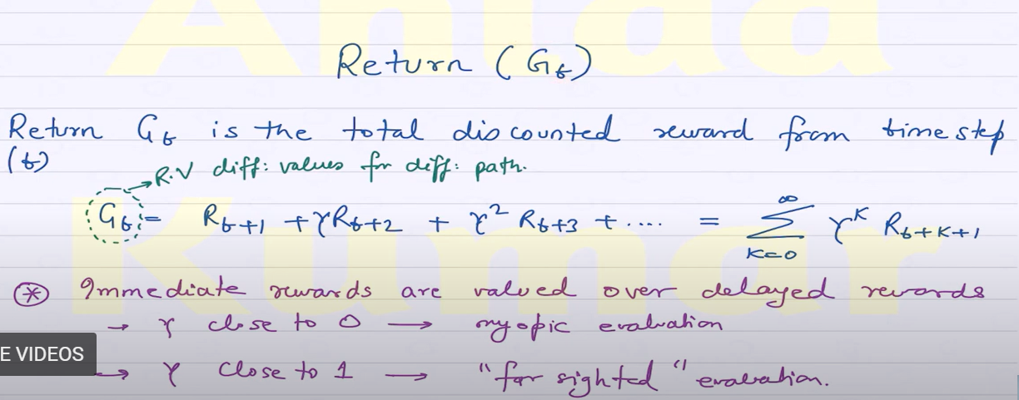

Slide 2
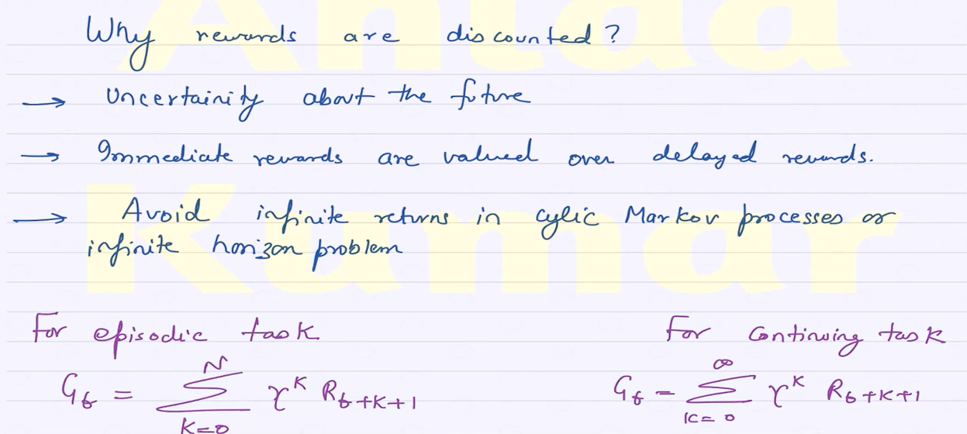

Slide 3
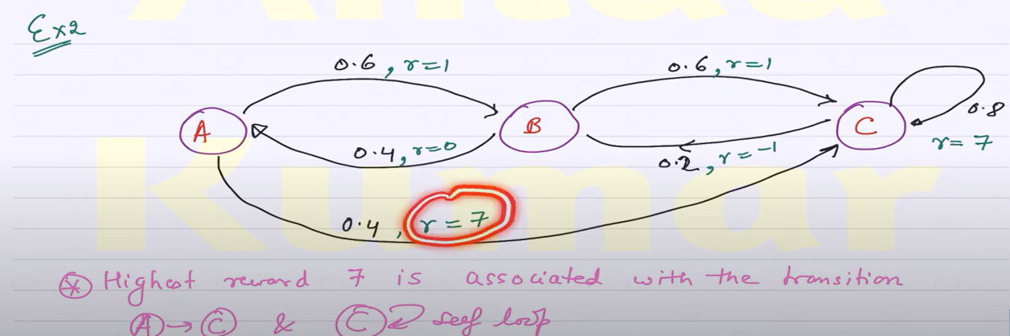

Slide 4
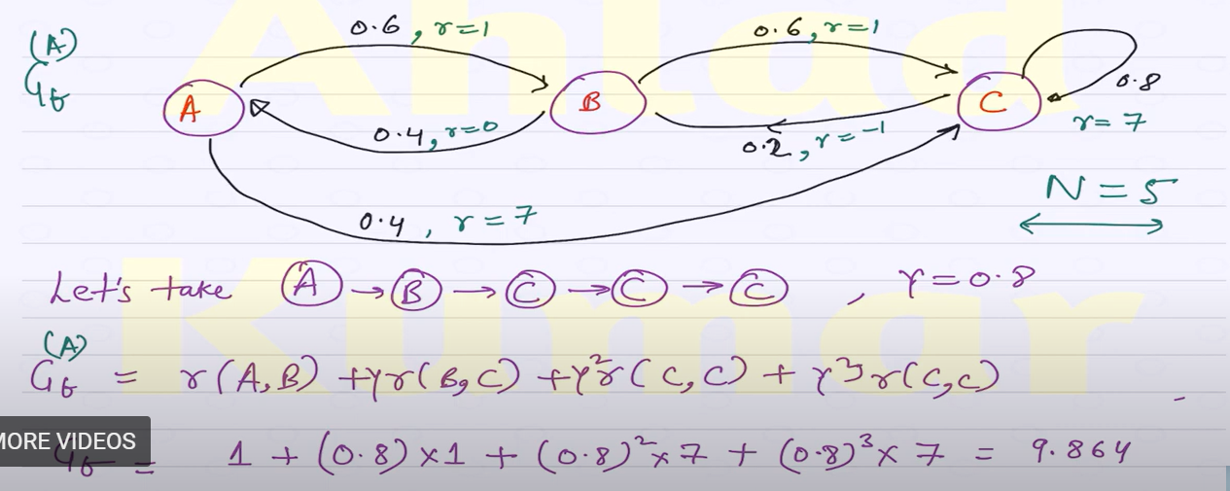

Slide 5
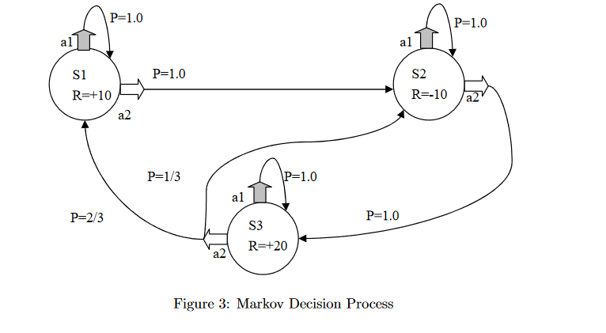

Slide 6
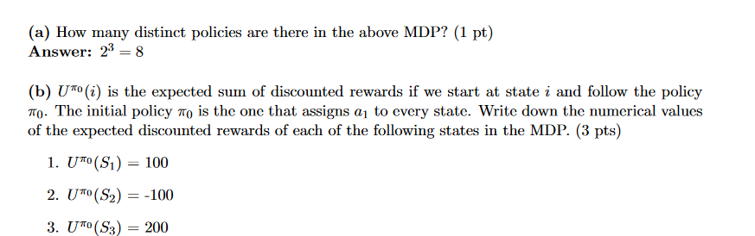

Slide 7
Question:
Consider a MDP where the following sequence of rewards is received: R₁ = -1, R₂ = 2, R₃ = 6, R₄ = 3 and R₅ = 2. Assume that the return G₅ = 0 (at the terminal state T = 5). Assume that the discount factor γ = 0.5.
Hint: Return is defined as G_{t} = R_{t+1} + γ R_{t+2} + γ² R_{t+3} + γ³ R_{t+4} + …
Use the above to derive a relationship between G_{t} and G_{t+1.}
What are the values of G₀, G₁, G₂, G₃ and G₄?
Solution:
G_{t} = R_{t+1} + γ R_{t+2} + γ² R_{t+3} + γ³ R_{t+4} + … = R_{t+1} + γ (R_{t+2} + γ R_{t+3} + γ² R_{t+4} + …)
G_{t} = R_{t+1} + γG_{t+1} 1.5 marks
G₅ = 0
G₄ = R₅ + γG₅ = 2 + (0.5 x 0) = 2 0.5 marks
G₃ = R₄ + γG₄ = 3 + (0.5 x 2) = 4 0.5 marks
G₂ = R₃ + γG₃ = 6 + (0.5 x 4) = 8 0.5 marks
G₁ = R₂ + γG₂ = 2 + (0.5 x 8) = 6 0.5 marks
G₀ = R₁ + γG₁ = -1 + (0.5 x 6) = 2

Slide 8
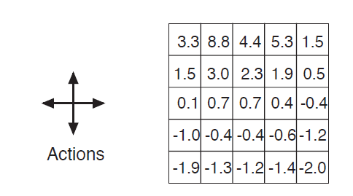

Ques 2: Consider the grid world shown below:
All four actions (right, left, up and down) are equiprobable. In the figure above, the value function, V^{π} at each state in the grid is provided, for the case where discount factor g = 0.9. Show numerically that the Bellman equation given below applies for the center state valued at 0.7, with respect to its four neighboring states, 2.3, 0.4, -0.4 and 0.7. Assume that R(s) at all states is zero.

Slide 9
0.7 = 0.9 x [(0.25 x 2.3) + (0.25 x 0.4) + (0.25 x -0.4) + (0.25 x 0.7)] = 0.675 ≅ 0.7

Slide 10
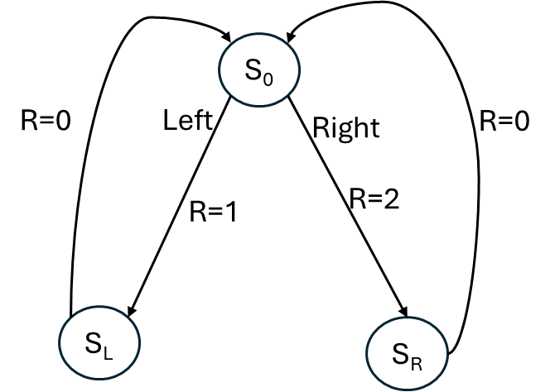
R=0
Question 1:
Consider the continuing Markov Decision Process shown above. The only decision to be made is in the top state (S₀), where two actions are available, left and right.
The numbers (e. R=0, R=1, R=2) show the rewards that are received deterministically after each action. There are exactly two deterministic policies, π_{left} and π_{right}.
Calculate and show which policy will be the optimal if: (i) γ = 0;
(ii) γ = 0.9; (iii) γ = 0.5.

Slide 11
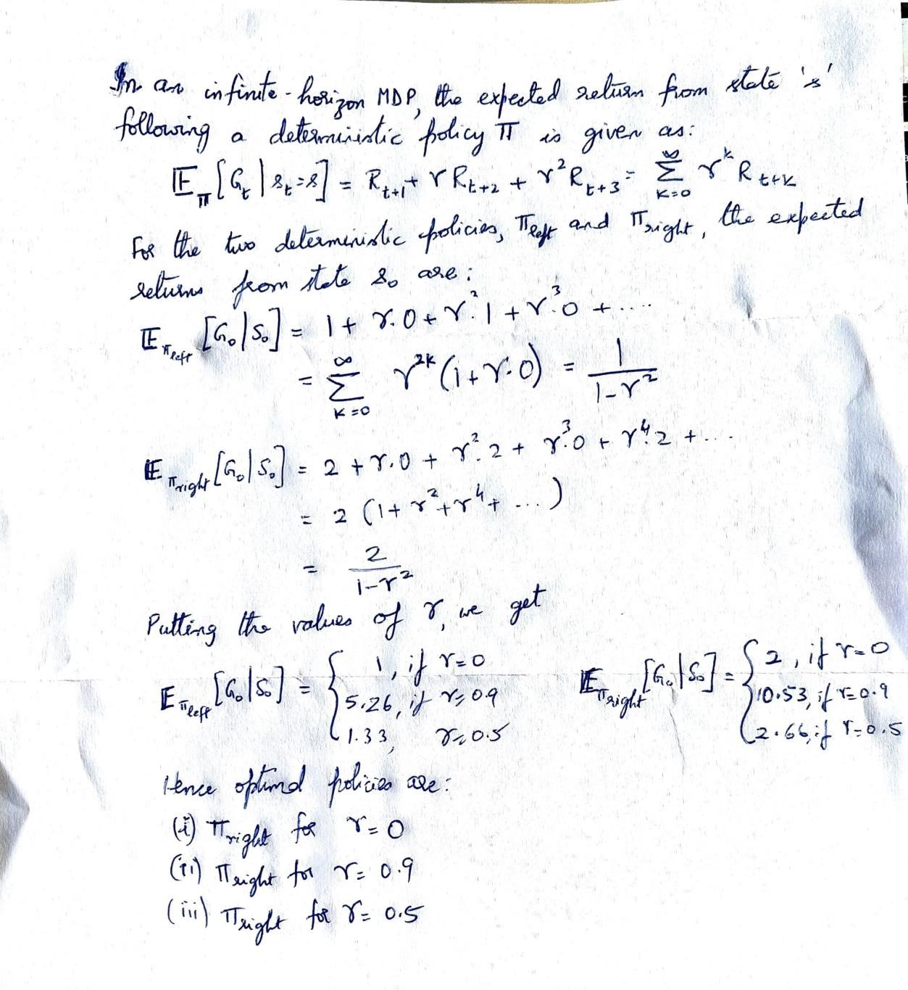
solution

Slide 12
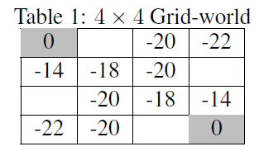
Question
Consider a 4×4 Grid-world problem where the goal is to reach either the top-left corner or the bottom-right corner (refer to Figure below).
The agent can choose from four actions up, down, left, right, which deterministically cause the corresponding state transitions, except that
actions that would take the agent off the grid leave the state unchanged. We model this as an undiscounted, episodic task, where the reward
is −1 for all transitions. Suppose that the agent follows the equiprobable random policy, π.
Given above is the partial value function for this problem. Calculate respectively, the missing values in the first and second row?
Vs=Rs+γ(P(s,π(s))V(s’))

Slide 13
solution
Recall Bellman Expectation Equation,
V(sR(s)+γs'Ps,πsV(s')
Let the state value in the grid at first row second column be v₁. Then, applying Bellman Expectation Equation, we have:
v₁ = 0.25 × [(−1 + 0) + (−1 − 20) + (−1 − 18) + (−1 + v₁)]
= 0.25 × [− 42 + v1]
=⇒ v1 = −14 3 marks
Let the state value in the grid at second row fourth column be v2. Then, applying Bellman Expectation Equation, we have:
v2 = 0.25 × [(−1 − 20) + (−1 − 22) + (−1 − 14) + (−1 + v2)]
= 0.25 × [− 60 + v2]
=⇒ v2 = −20 3 marks

Slide 14

Question
Consider an MDP, M(S, A, P, R, γ) with 2 states S = {S1, S2}. From each state there are 2 available actions A = {stay, go}.
Choosing “stay” from any state leaves you in the same state and gives reward -1.
Choosing “go” from state S1 takes you to state S2 deterministically giving reward -2, while choosing “go” from state S2 ends the episode giving reward 3.
Given the Bellman equation:
Draw the Markov diagram for the above transitions

Slide 15
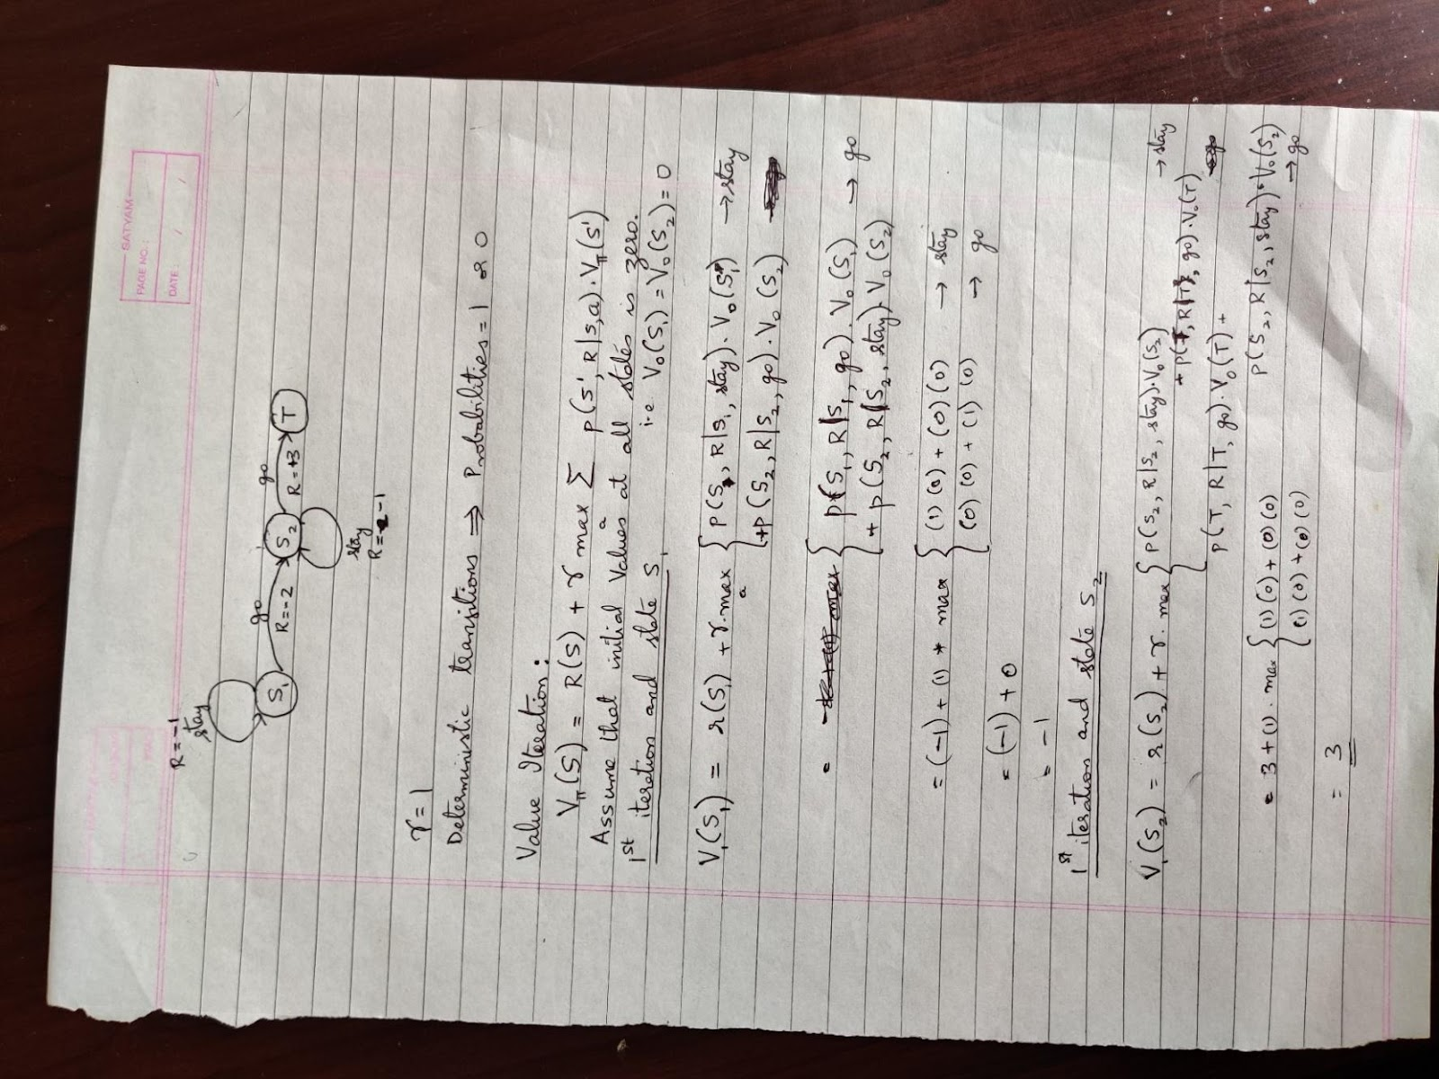
solution

